Slide 1
Error Prediction on Speech Recognition using NLP
Abhishek Verma

Slide 2
Table of Content
Overview
Data Source
Speech Conversion Statistics
Feature Engineering
Data Transformation
Modelling
Error Prediction Performance
Conclusion
Presentation Duration : 20 min

Slide 3

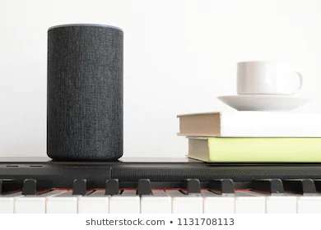
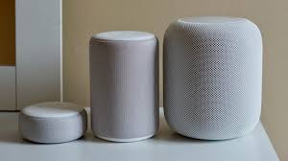
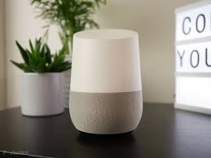
Overview: Speech Recognition
We are currently using many tools and instruments that operate on human voice based command. Most essential procedure to make this possible is to use the speech to text conversion routine.
The main function here is to take input as audio signals and convert to textual information that can then be used in algorithms.

Slide 4
Overview: Speech Recognition having Errors ?
However, in real world scenario, these voice commands are coupled with background noises. Sources of noise could be from the outside traffic, public chatters, road noise in cars etc.
Can the noise interference have some effects on the textual interpretation? Do we have evidence to show?
If so, can we predict the errors using machine learning tools and apply correction to them? How accurate can we get ?

Slide 5
Data Source: Audio Clips
I use the audio clips from clean and noisy parallel speech database used in the study "Speech Enhancement for a Noise-Robust Text-to-Speech Synthesis System using Deep Recurrent Neural Networks" by C. Valentini-Botinhao, X. Wang, S. Takaki & J. Yamagishi, In Proc. Interspeech 2016.
References: https://datashare.is.ed.ac.uk/handle/10283/2791

Slide 6
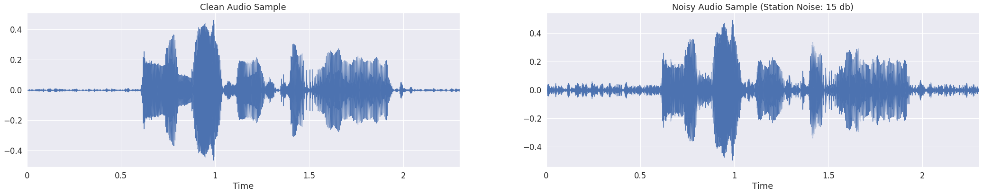

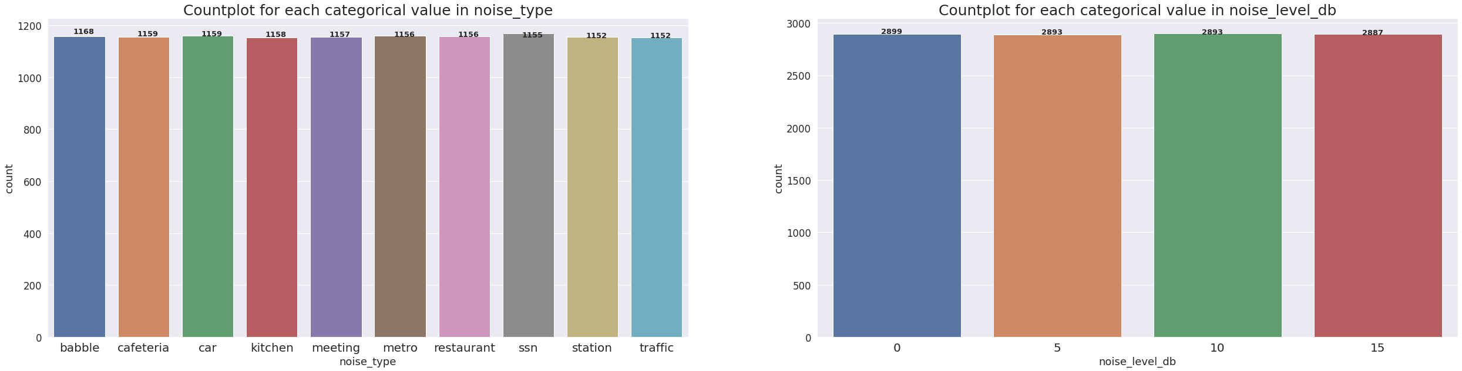
Data Source: Audio Clip Statistics
only
is
allowed
only
is
allowed
noise
noise
noise
water
water
currently
currently
Total 2 x 11000 audio clips

Slide 7
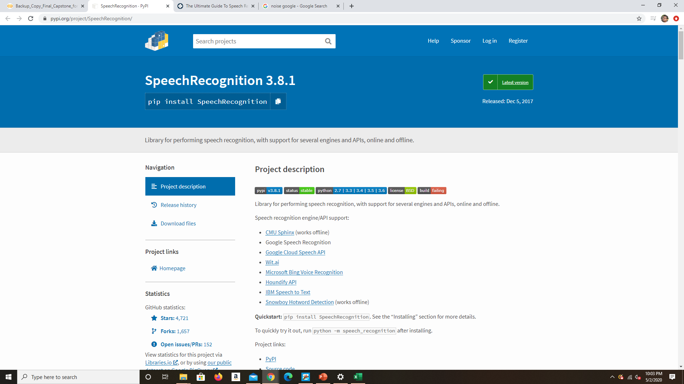
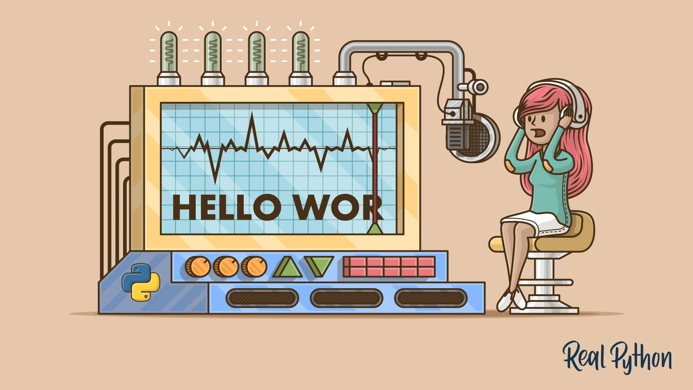
Data Source: Speech Recognition Tool
Python package to translate audio clips to text.
For this project, I use the google web speech API.
https://realpython.com/python-speech-recognition/

Slide 8
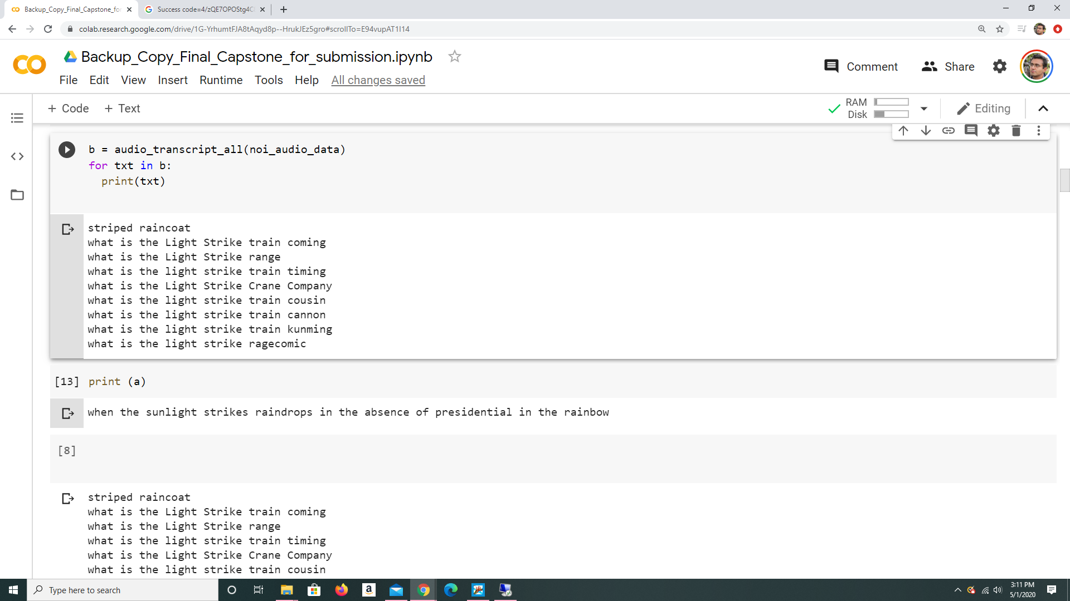
Speech Conversion: Clean Audio vs Noisy Audio
Clean Audio Example
Noisy Audio Example
Speech to Text :
Speech to Text :

Slide 9
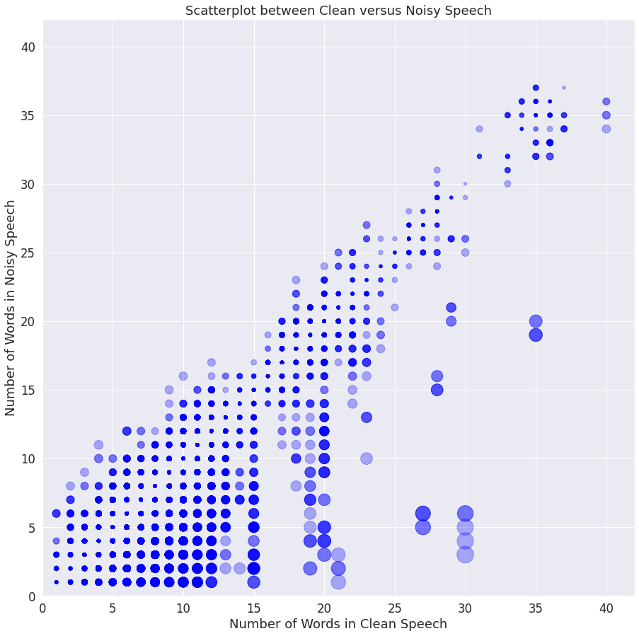
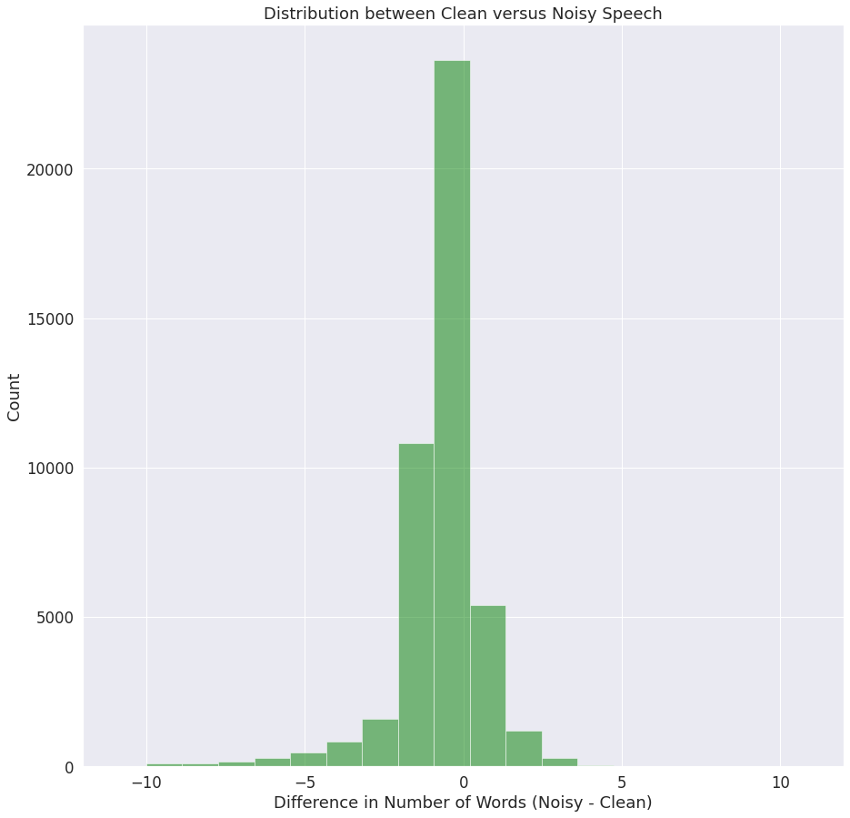
Speech Conversion Stats: Clean Audio vs Noisy Audio
More cases where the structure (num of words) doesn't change

Slide 10
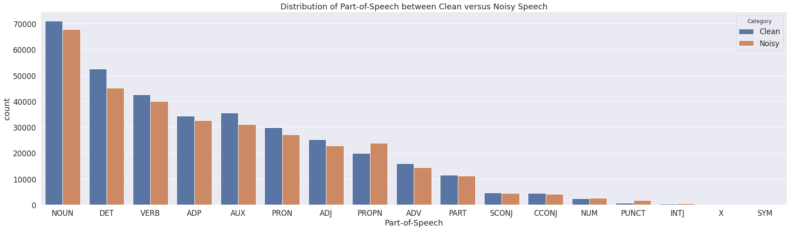
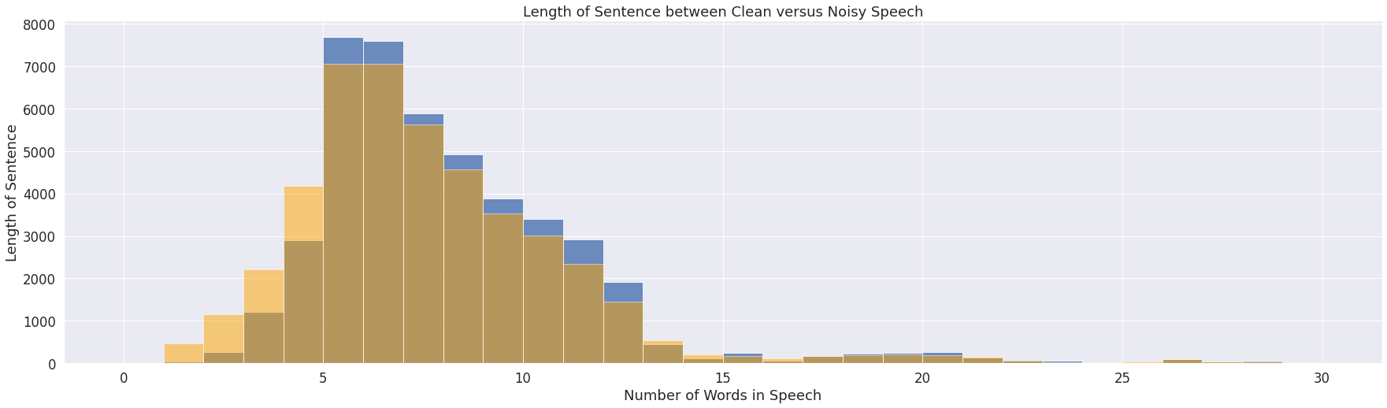
Speech Conversion Stats: Clean Audio vs Noisy Audio
Proper Noun content is higher in noisy speeches

Slide 11
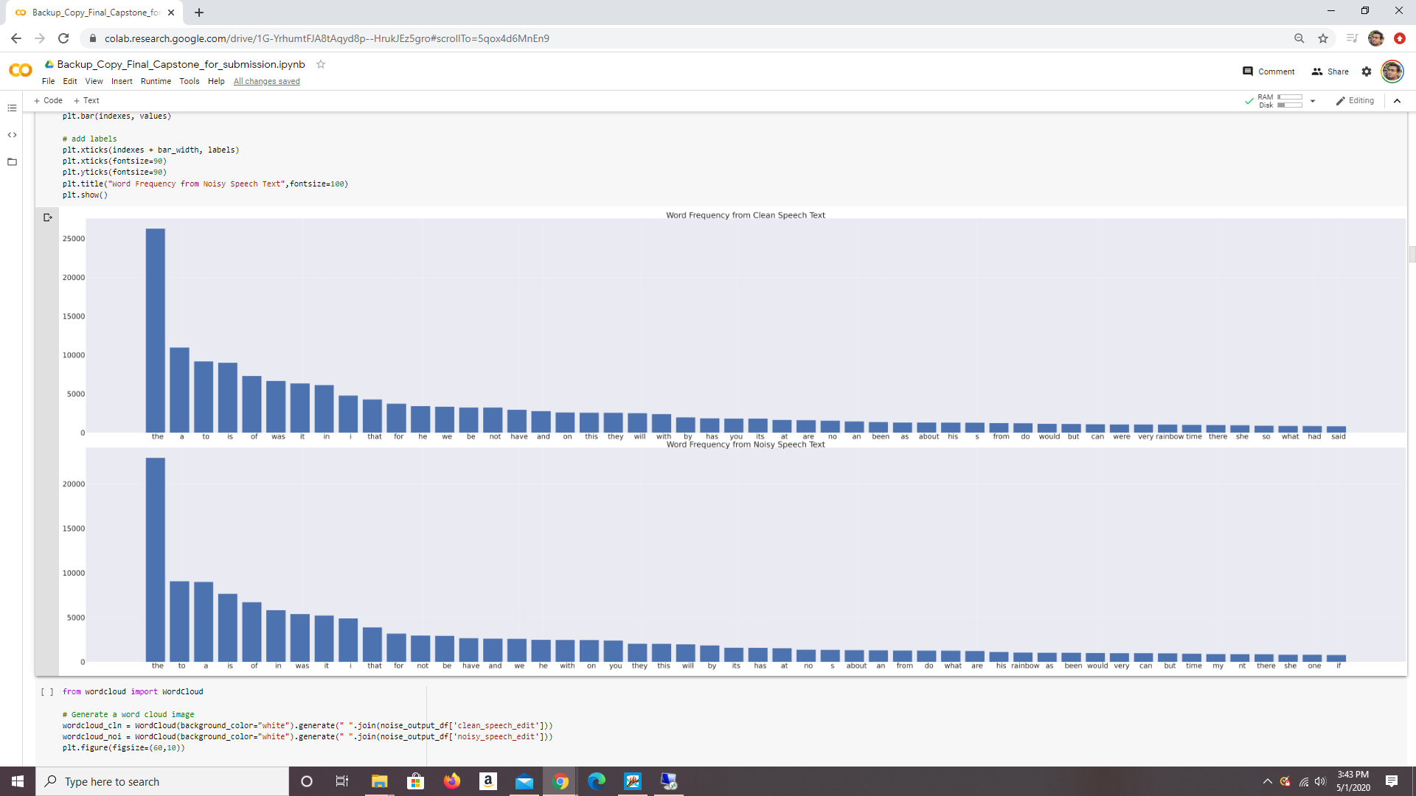
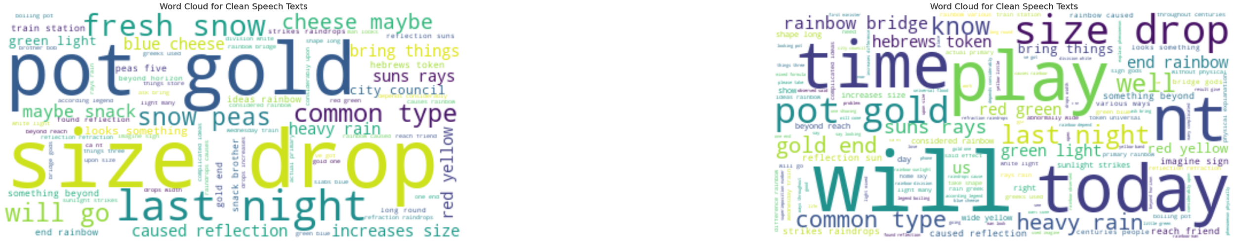
Speech Conversion Stats : Word Frequency
Clean Speech Statistics
Noisy Speech Statistics

Slide 12
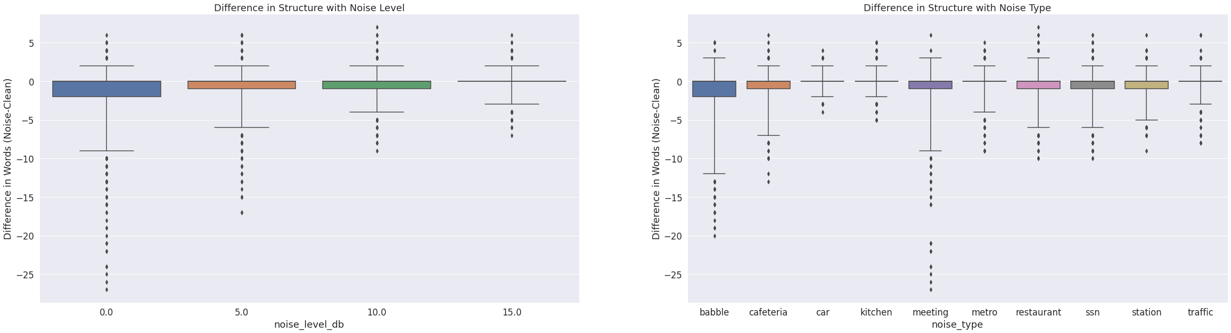
Speech Conversion Stats: Effect of Noise
Lower dB noise in speech generate more structure difference.
Noise-type such as babble, cafeteria, meeting etc. give more variability in structures.

Slide 13
Observation: Speech Recognition Errors
The presence of background noise affect the textual speech conversion from audio content.

Slide 14
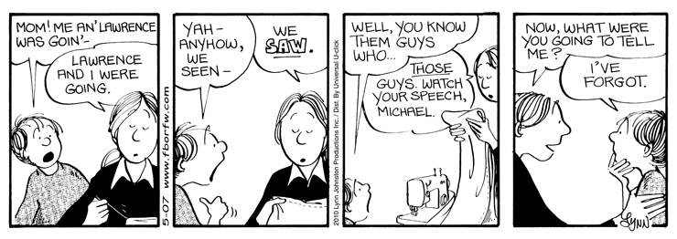
Objective: Speech Error Prediction
Construct a deep learning modelling using NLP to predict speech recognition errors generated as a result of background noise.
In particular the model will predict wording error on speech translated texts.
https://www.danielcraig.com/2010/05/09/dangers-of-error-correction-for-better-or-for-worse-comic-strip/

Slide 15
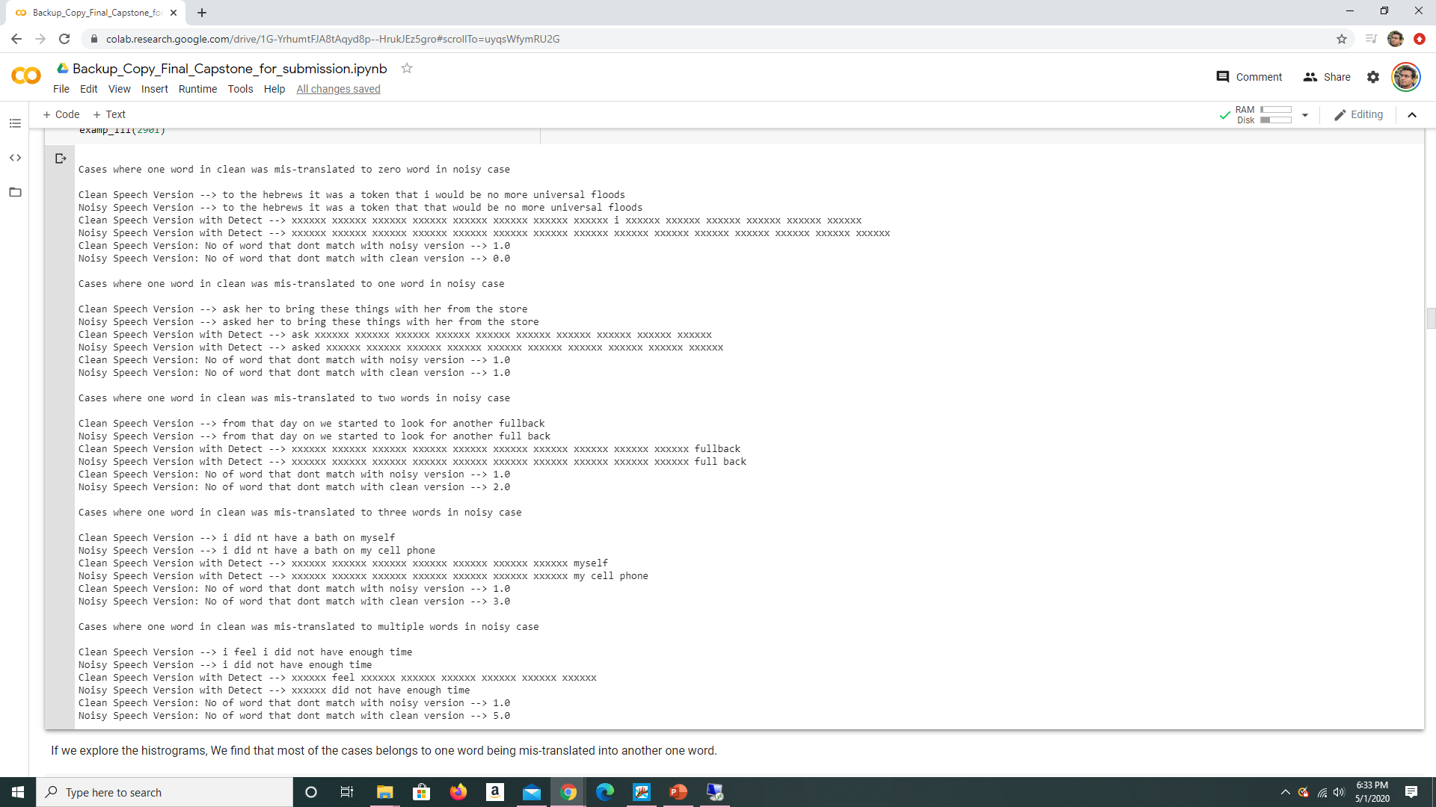
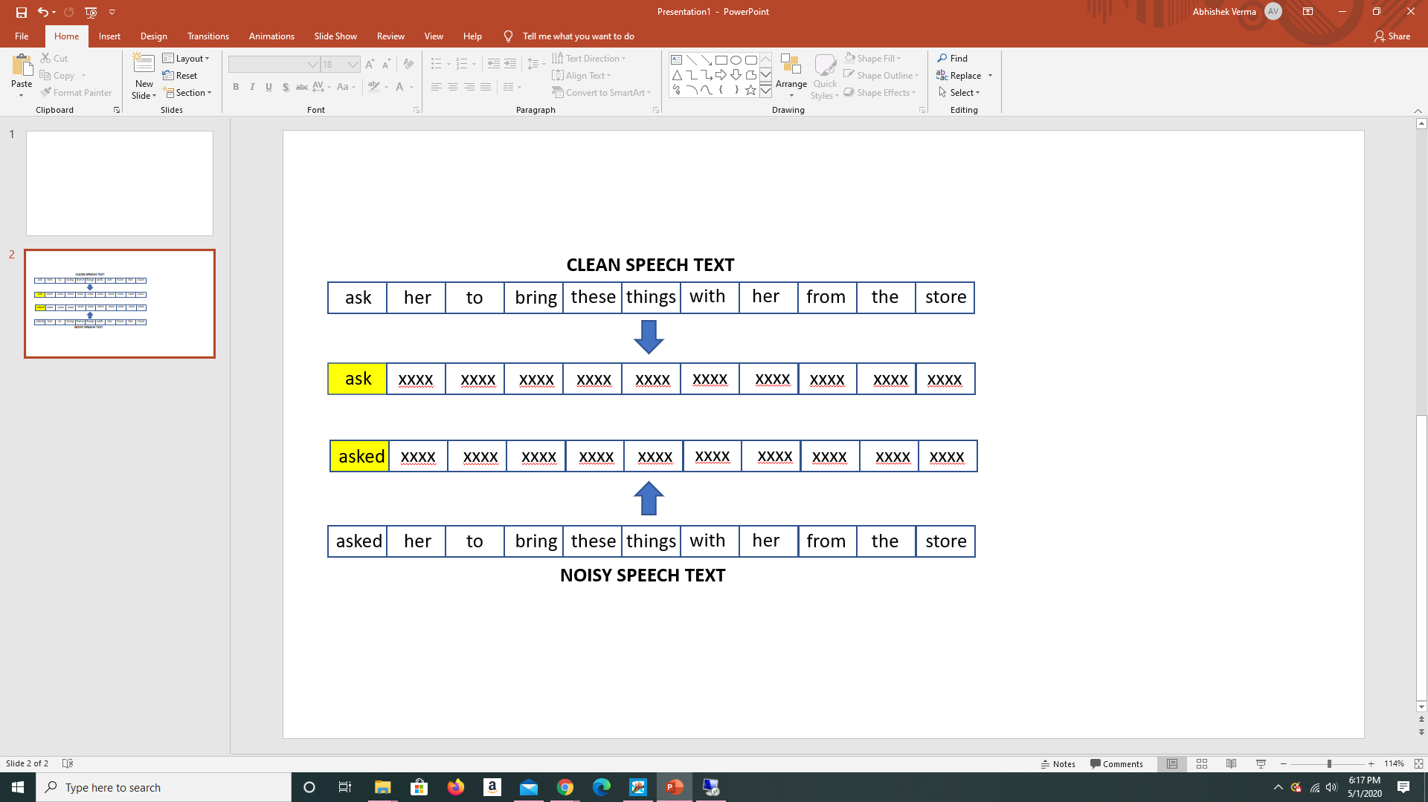
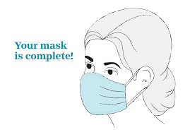
Data Transformation: Identify True vs Error Words
Mask all common words
True
Error

Slide 16
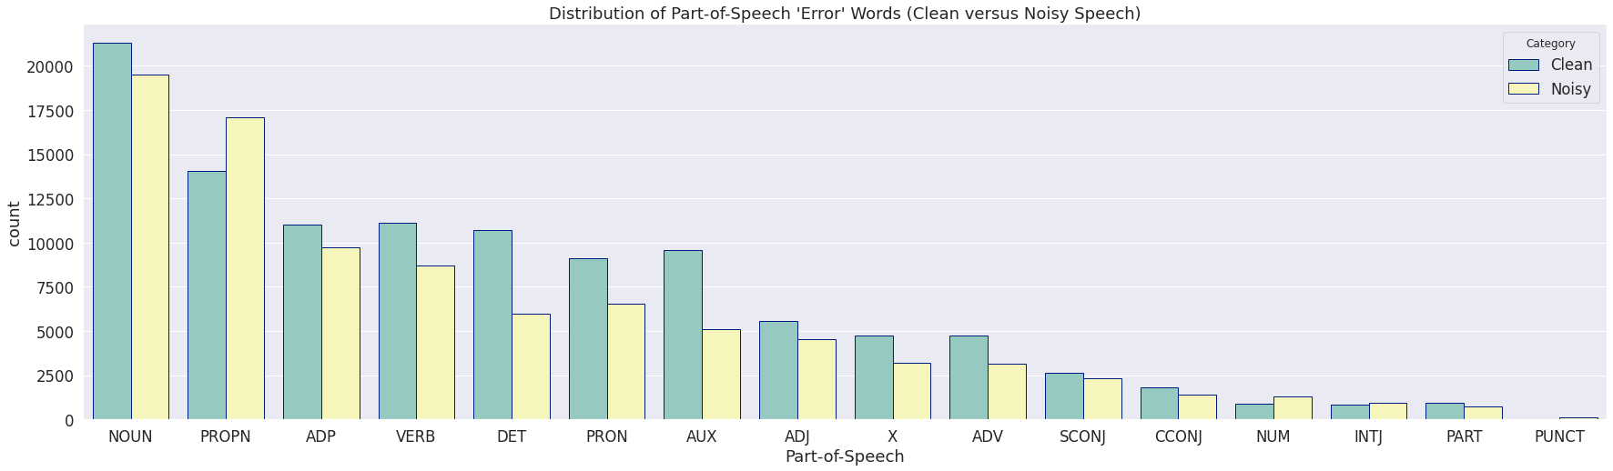
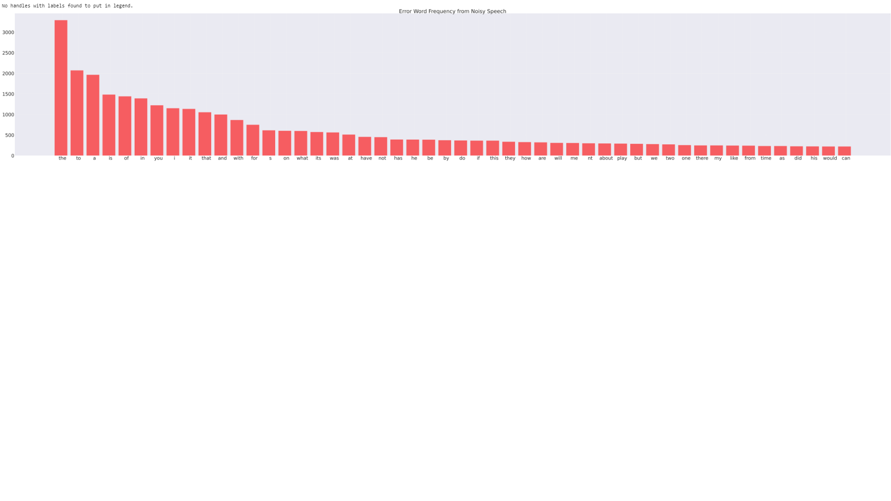
Data Exploration: True vs Error Words
More Error words generated as Proper Noun

Slide 17
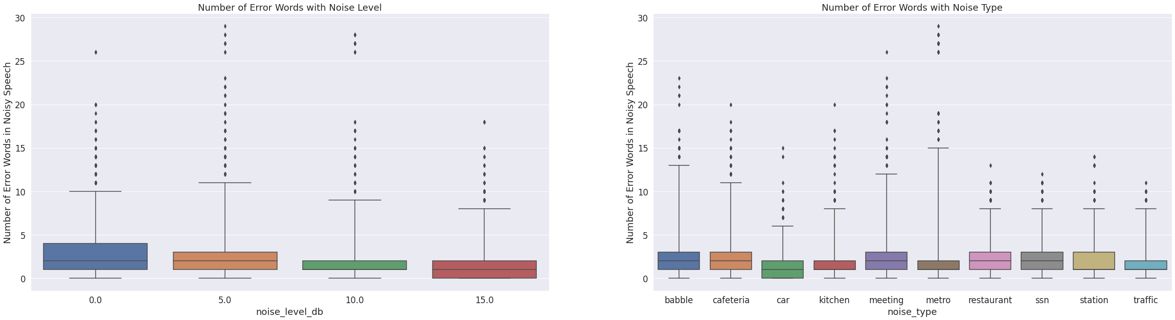
Data Exploration: True vs Error Words
Number of Error words are statistically more in cases where noise levels were low. (counter intuitive)

Slide 18
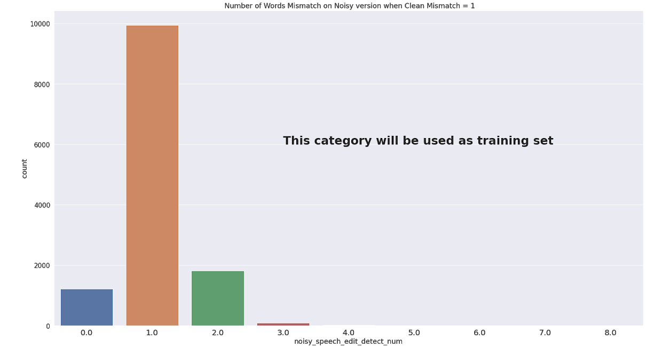
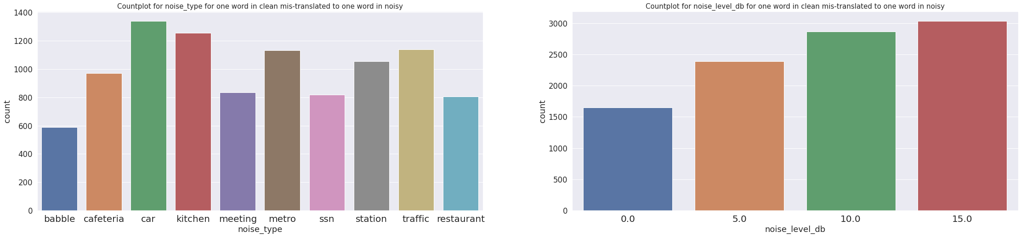
Feature Engineering: Data Selection
Multiple words can be mistranslated as speech errors.
In total 9939 sample with error in translating one word.

Slide 19
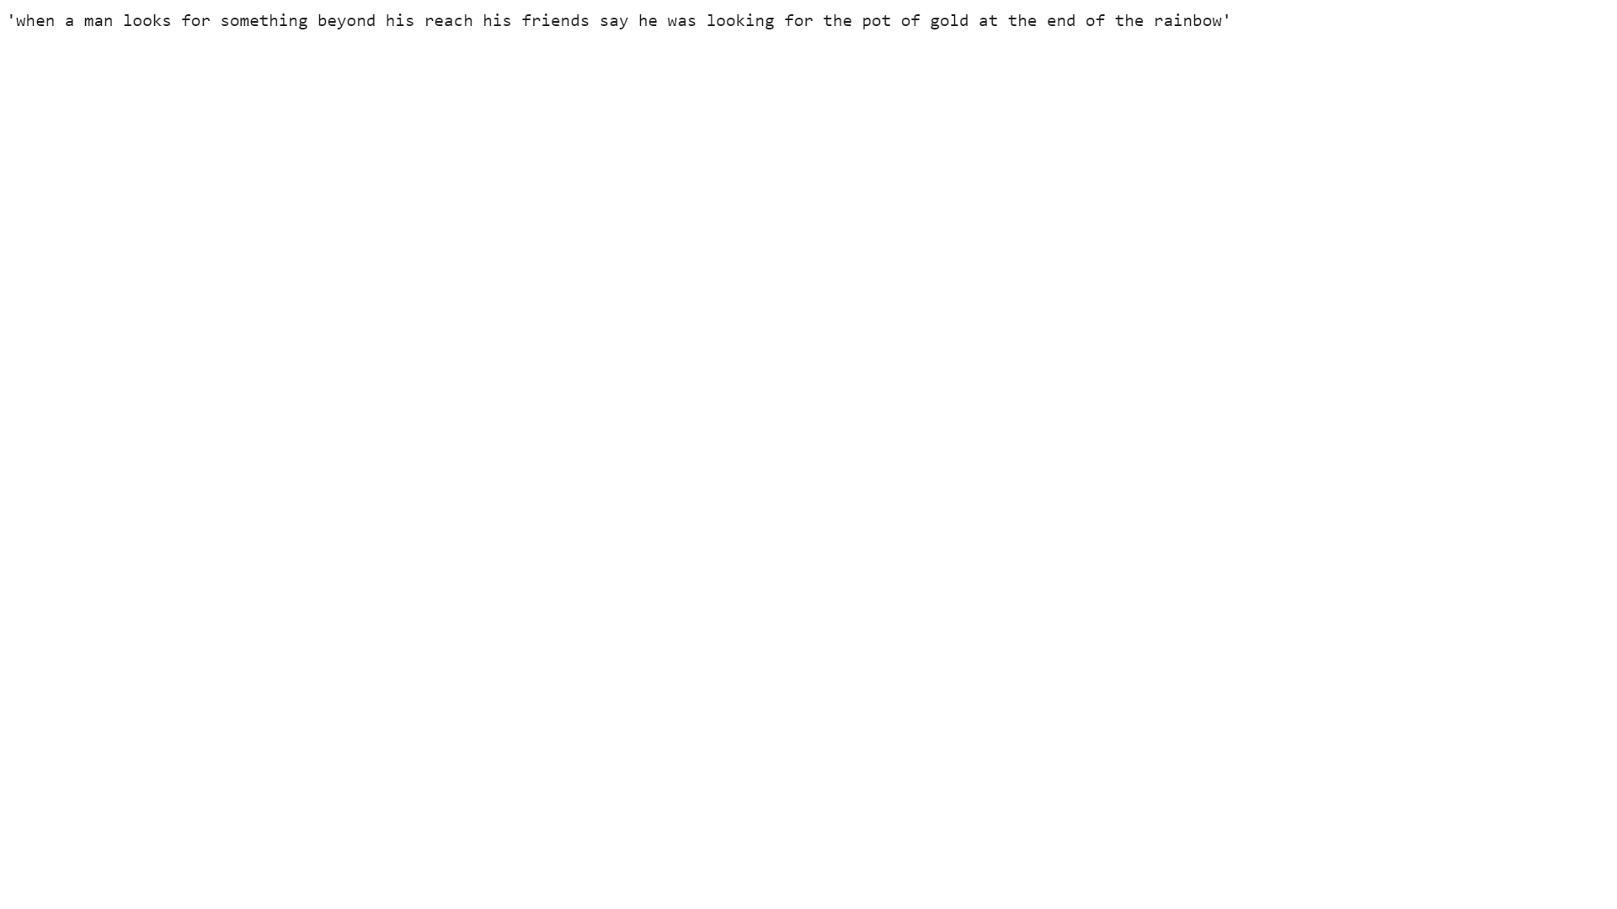
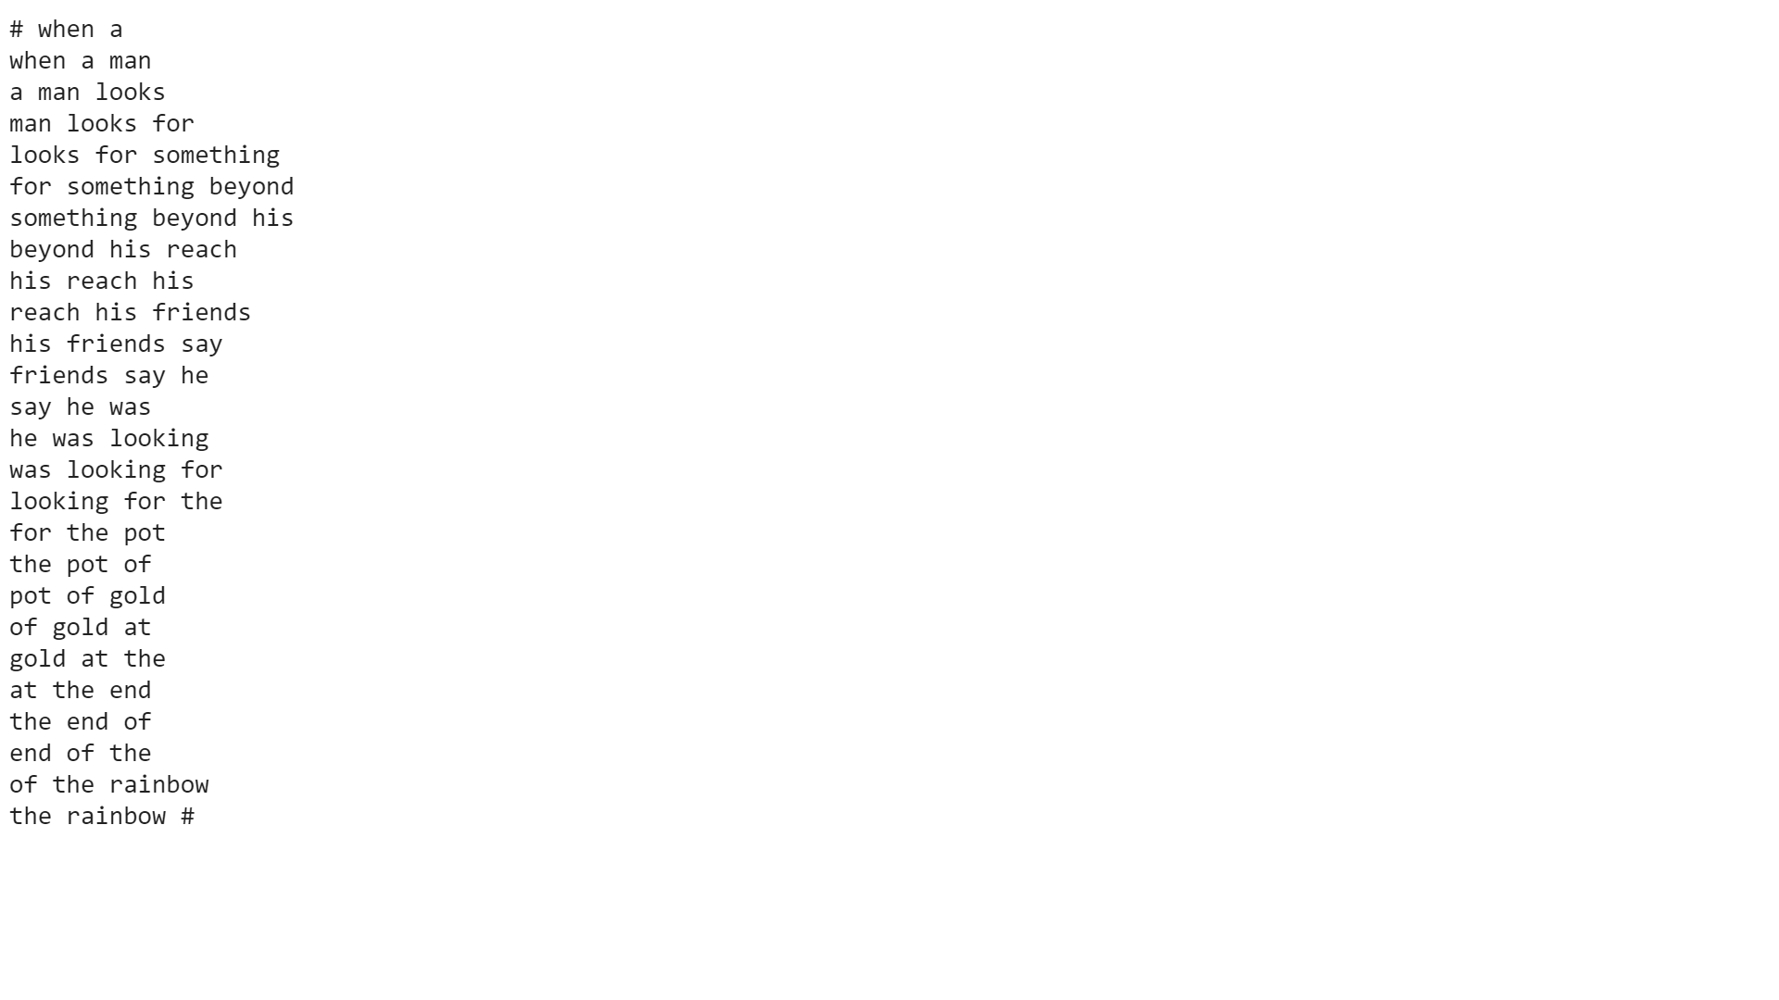
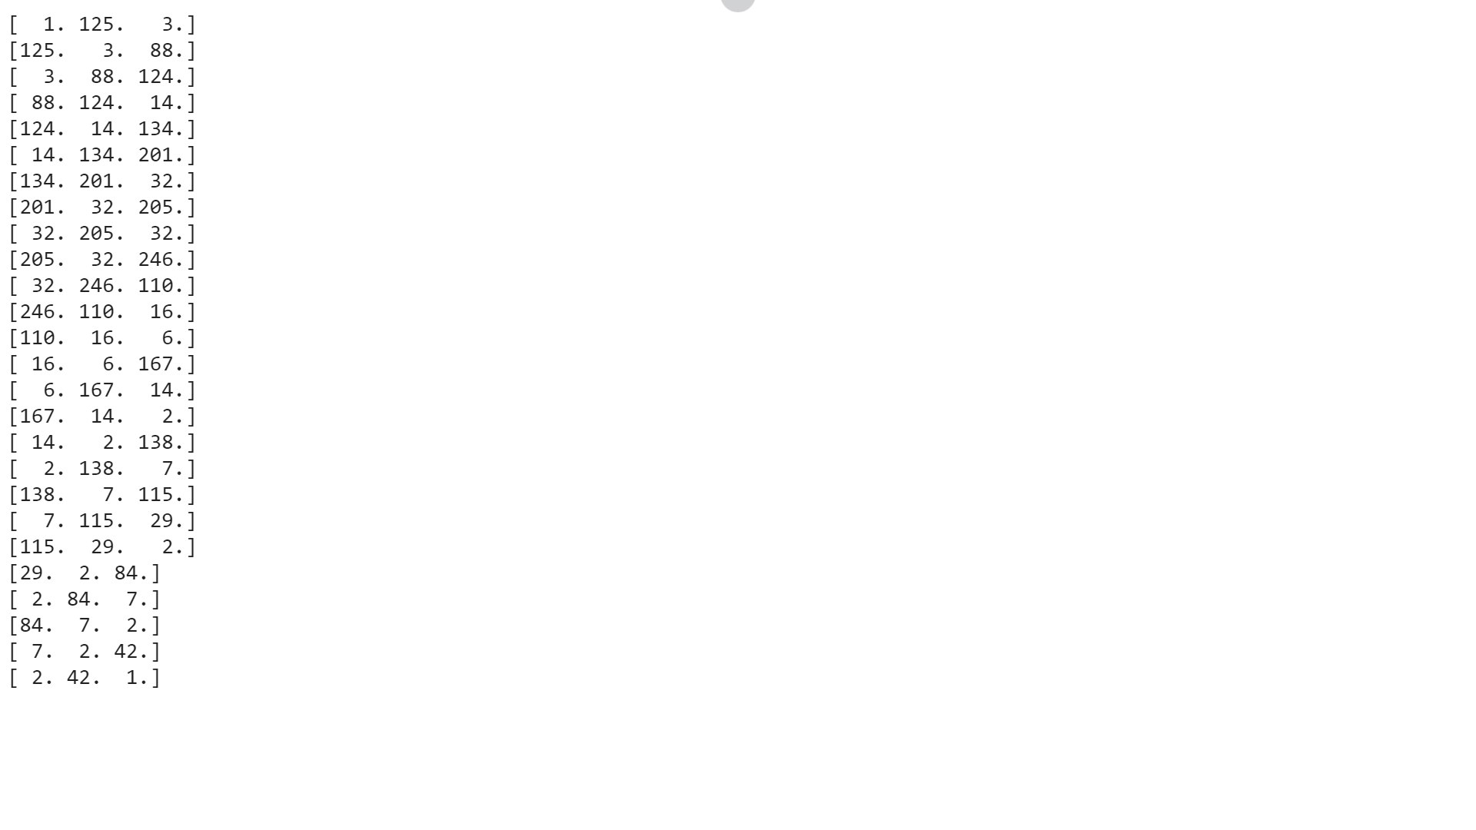


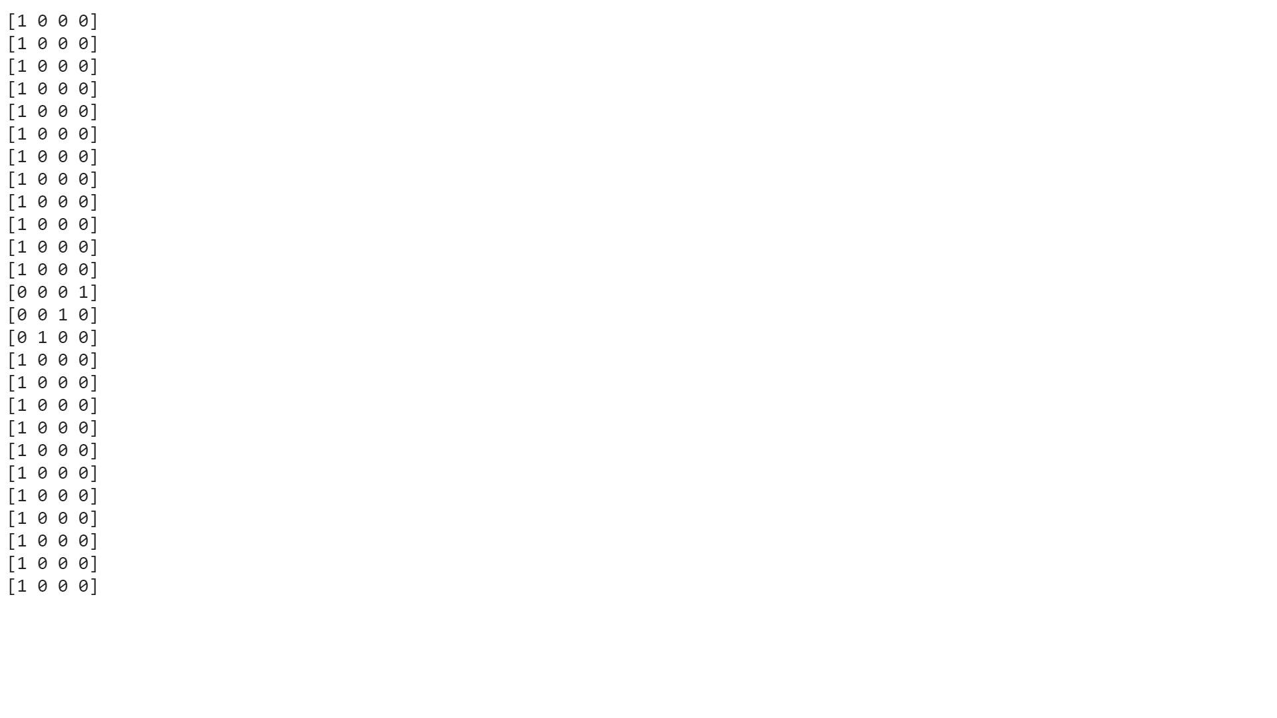
Data Transformation
Input Sentence
Error word
Output Error Word
DEEP LEARNING MODEL

Slide 20

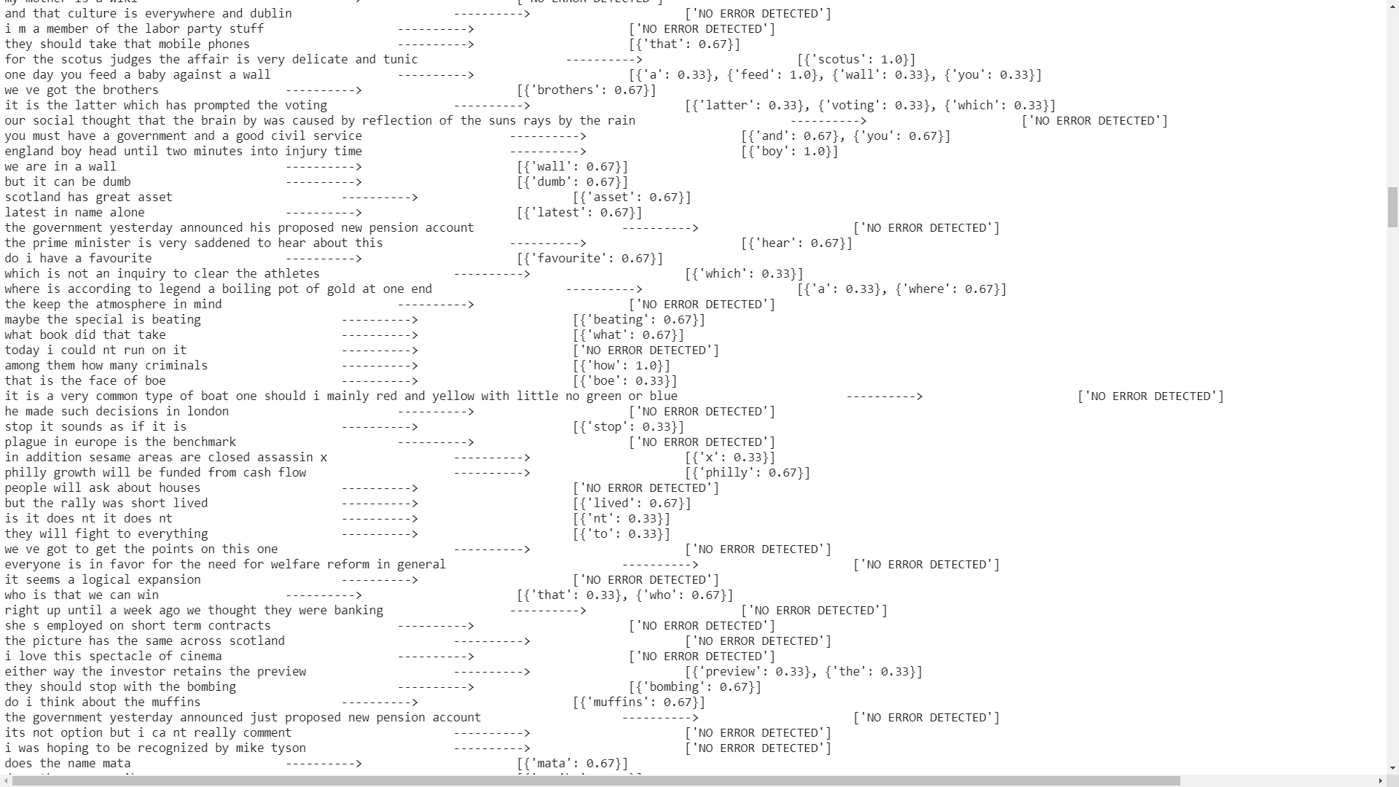

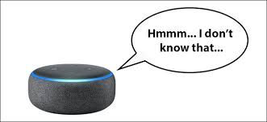
Modelling: Deep Learning NLP Model
Error word : Probability Score

Slide 21
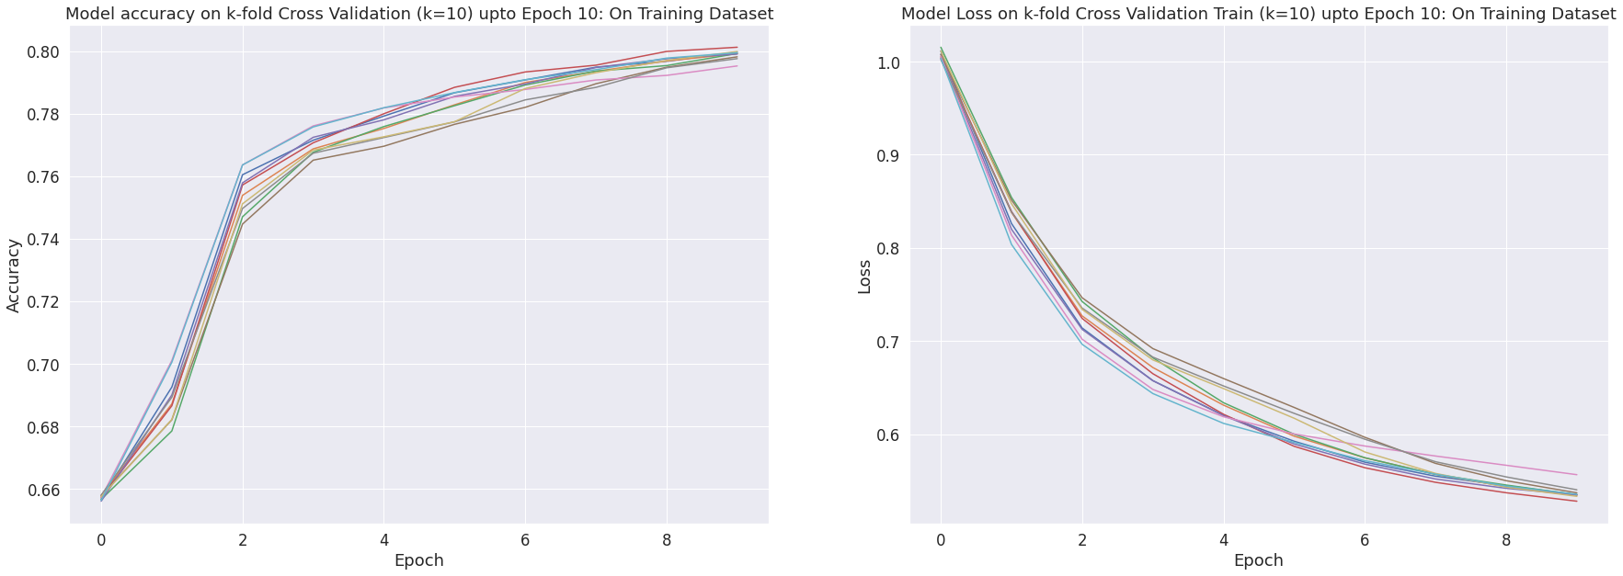
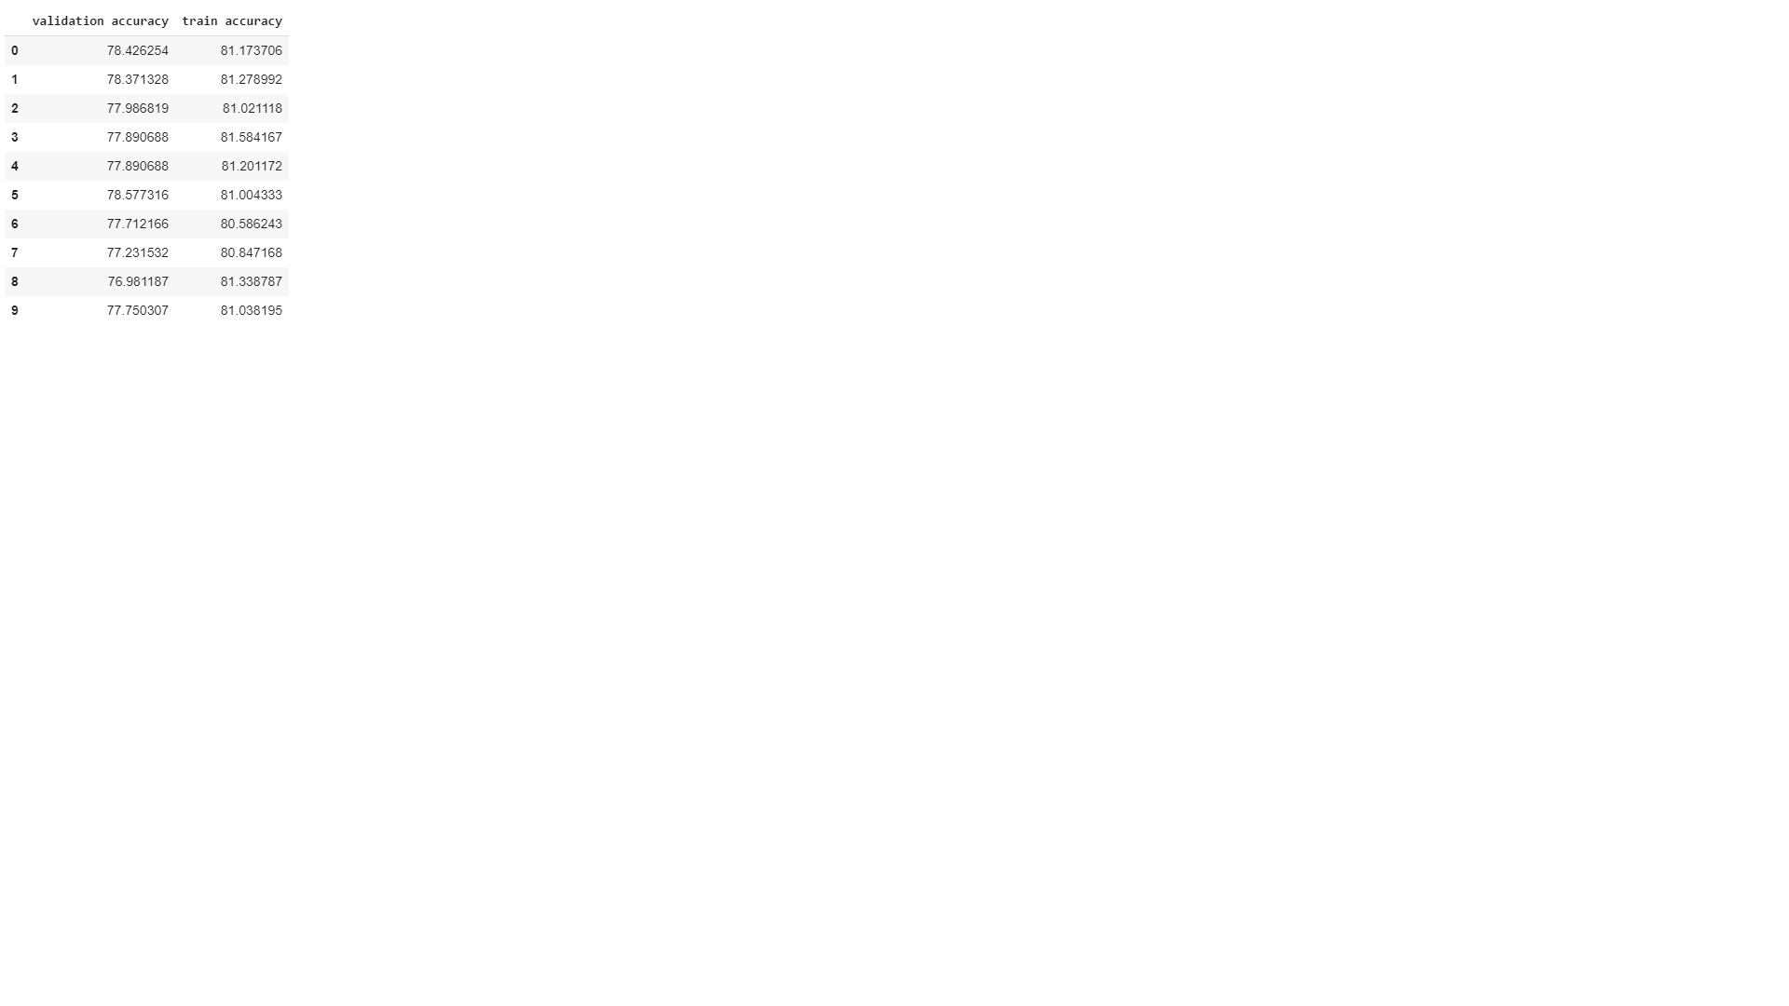
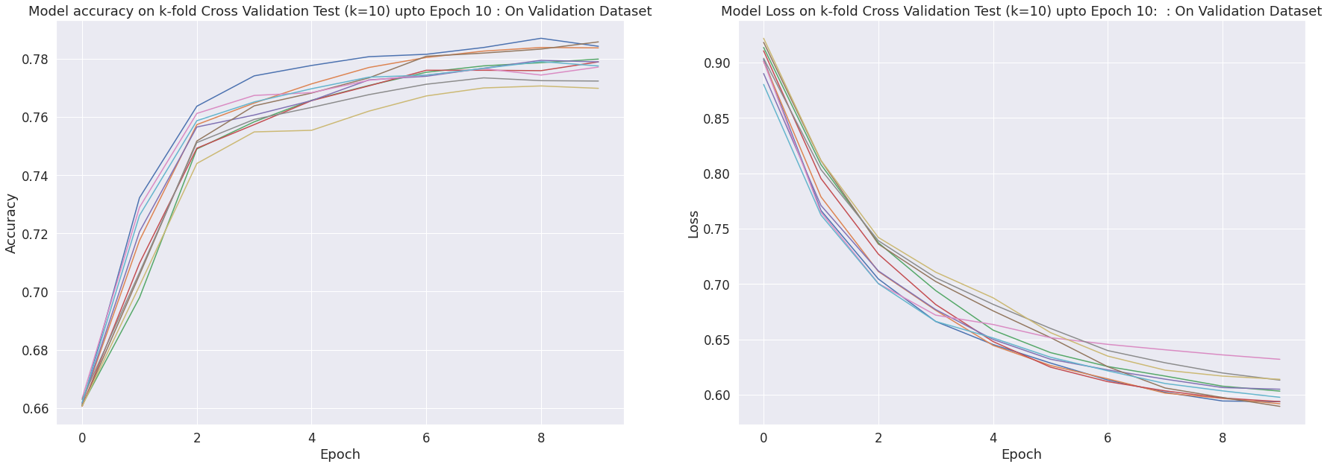
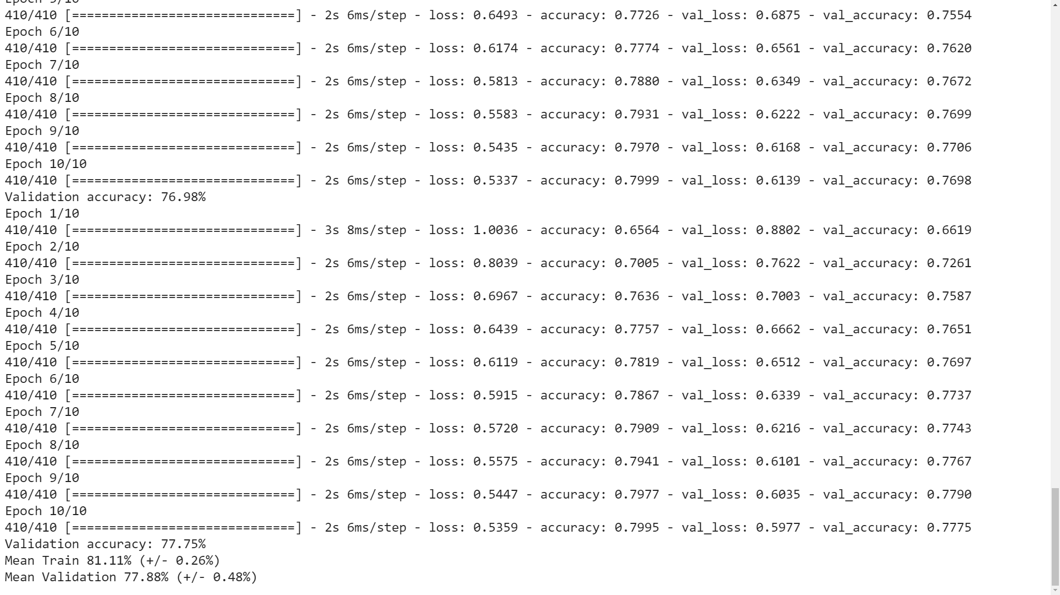
Modelling: K-Fold Performance
Training
Training
Validation
Validation

Slide 22
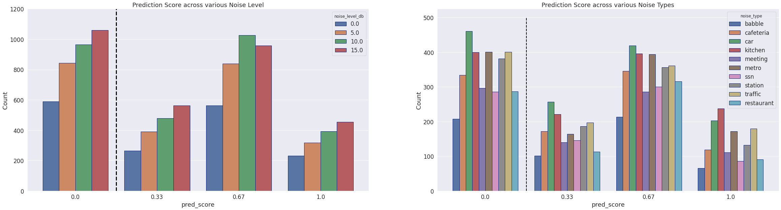
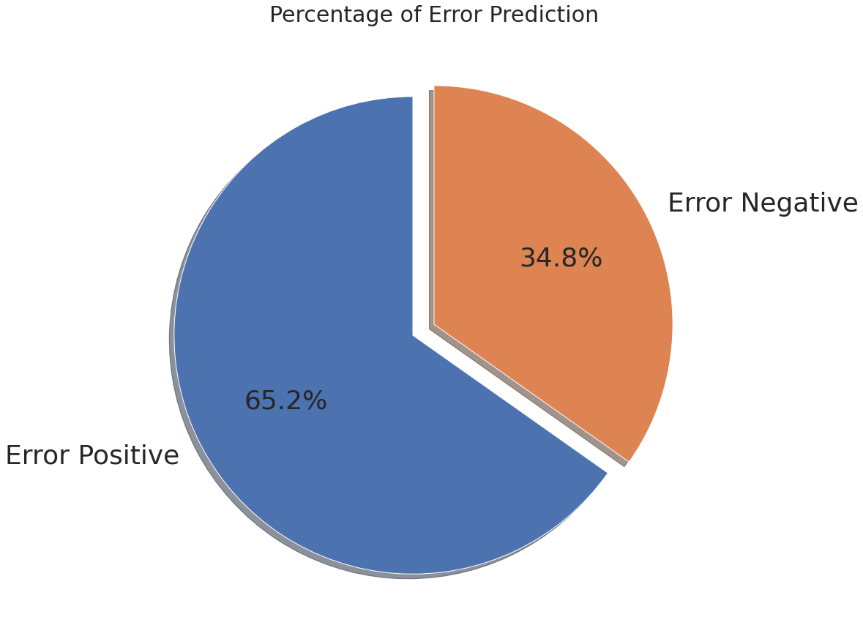
Modelling: Error Prediction Performance
Prediction scores distribution have similar pattern across various noise levels and noise types.

Slide 23
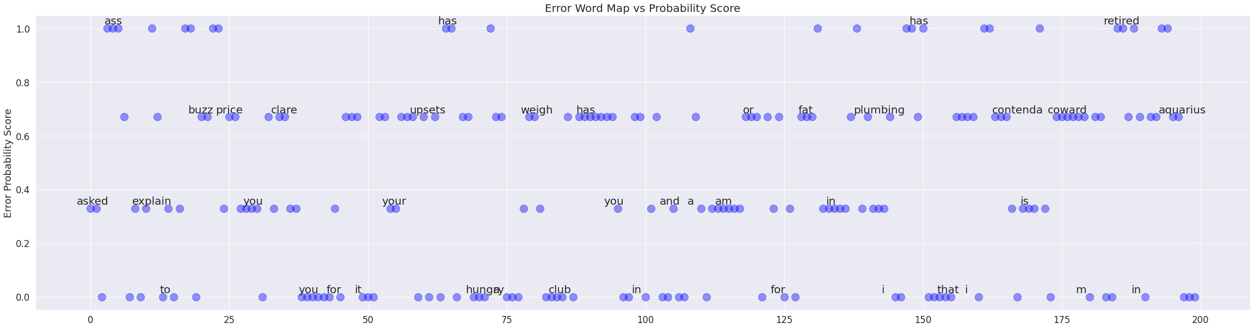
Modelling: Word Map from Probability Score
(first 200 sample)
Some common pattern in words observed among various score group.

Slide 24
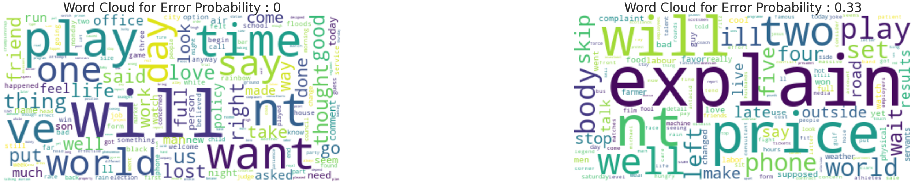
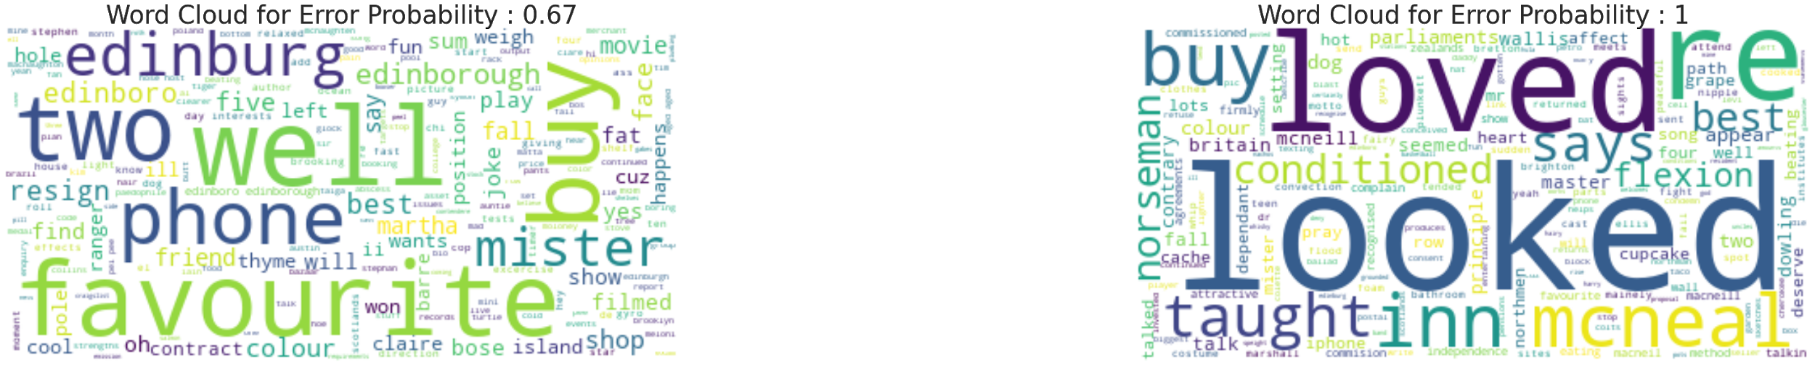
Modelling: Word Cloud from Probability Score

Slide 25
Modelling: Limitation
Modelling predict errors in one wording only.
Speech translation errors can also be made by other sources such as mispronunciations, language accent, voice quality etc.
Training data is limited and need data augment to generalize the model.

Slide 26
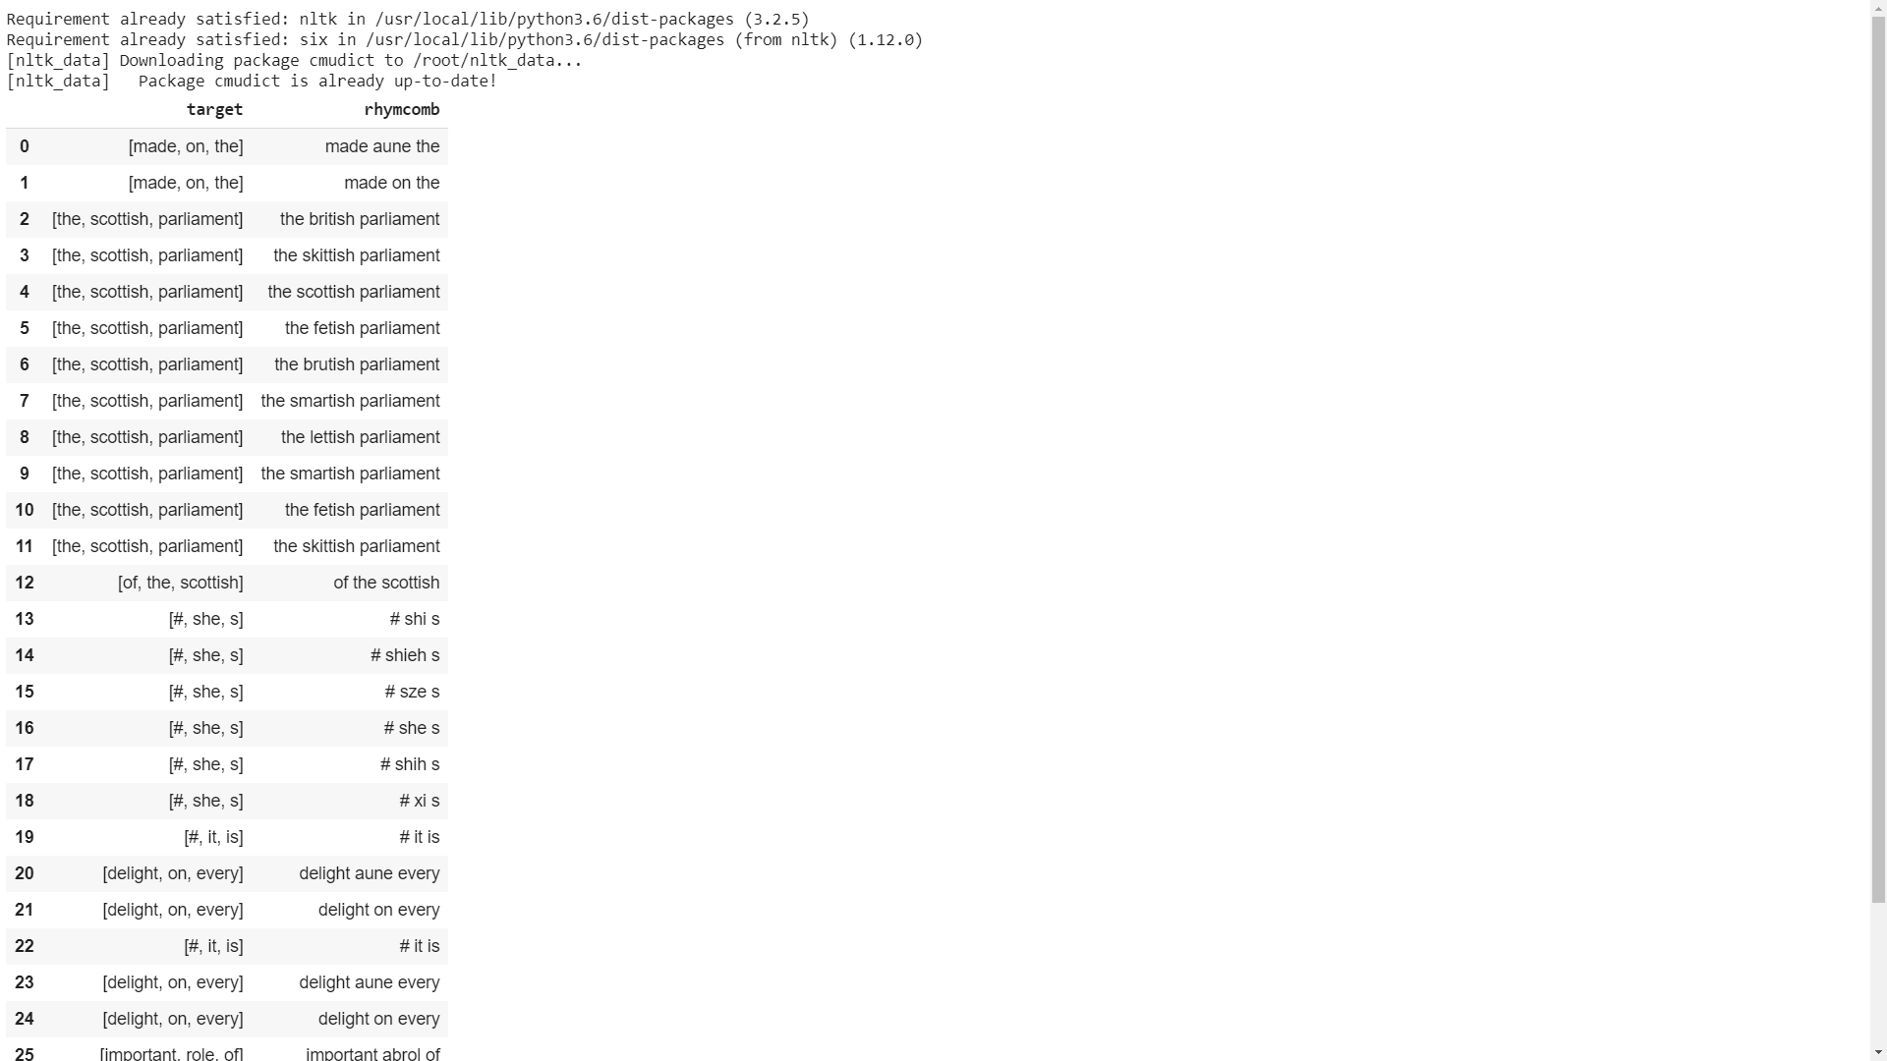
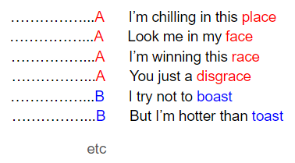
Modelling: Future Directions
Data augmentation by adding rhyming word to modelling inputs.
Rhyming or Rapping

Slide 27
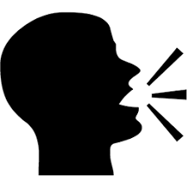
Implementation
Speech Error Prediction
Speech Correction
Speech Recognition
Text Translation

Slide 28
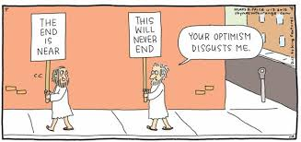
Conclusion
NLP and deep-learning model is shown to predict speech recognition error.

Slide 29
Questions ??

